Slide 1

Visualizações 3D para a web com WebGL
Visualizações 3D para a web com WebGL
Introdução ao Three.js
Introdução ao Three.js
Óscar Oliveira (oao@estg.ipp.pt)
Notes:
Fontes:
https://github.com/microsoft/cascadia-code
https://www.estg.ipp.pt/comunicacao

Slide 2
Conteúdos
Introdução
Renderer
Mesh
Geometrias
Materiais
Luzes
Animação
Conclusão

Slide 3
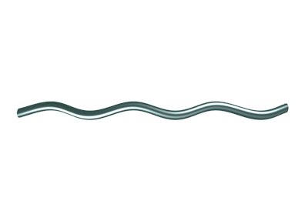
Introdução
Introdução
Imagem ^{[1]}

Slide 4

WebGL (Web Graphics Library) é uma API de JavaScript para a renderização de gráficos 2D e 3D interativos dentro de qualquer navegador da Web compatível sem a utilização de plug-ins. ^{[1]}

Slide 5

Three.js é um motor WebGL baseado em JavaScript que pode executar jogos movidos com GPU ou outros aplicativos gráficos diretamente do navegador. A biblioteca three.js fornece várias funções e APIs para desenhar cenas 3D em seu navegador. ^{[1]}

Slide 6




https://threejs.org/
https://github.com/mrdoob/three.js
/build
\exemplos\1-introducao

Slide 7
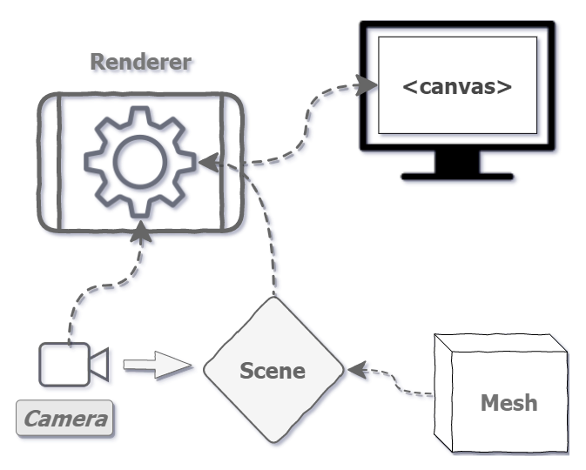
Renderer
Renderer
Imagem ^{[1]}

Slide 8
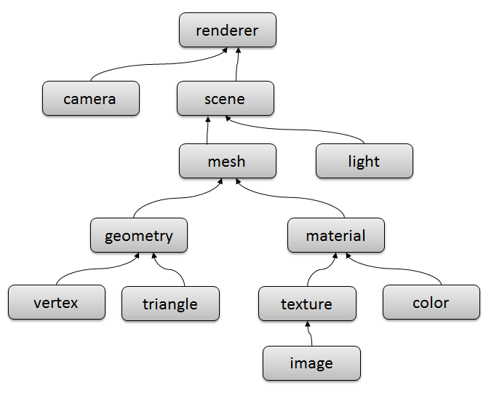
Objetos
Imagem ^{[1]}
Notes:
Scene - this is a holder for everything else. You can think of it as a “tiny universe” in which all your 3D objects live.
Camera - this is directly equivalent to the concept of a camera in the real world, and you’ll use this to view your scene.
Renderer - this is a machine that takes a Camera and a Scene as input and outputs beautiful drawings (or renderings) onto your <canvas>.
Mesh - this is just a holder for a Geometry and a Material and defines the position in 3D space. We can add this to our Scene.
Geometry - this defines the shape of our Mesh.
Material - and this defines the way that the surface of the Mesh looks.
https://discoverthreejs.com/book/first-steps/first-scene/

Slide 9
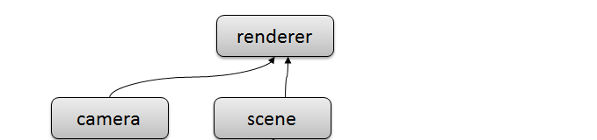
Objetos
Imagem ^{[1]}

Slide 10
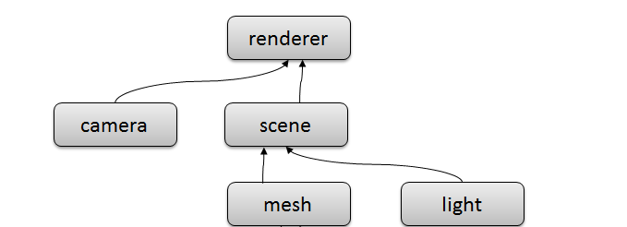
Objetos
Imagem ^{[1]}

Slide 11
Objetos
Imagem ^{[1]}

Slide 12
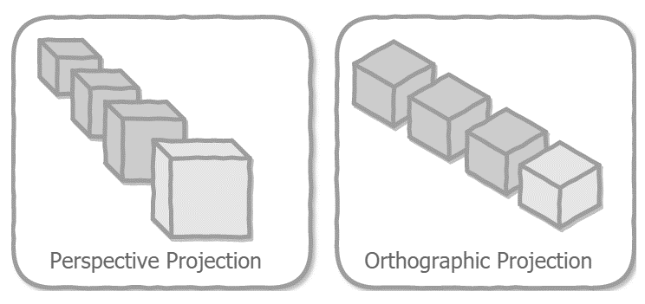
Camera
Imagem ^{[1]}
Notes:
We’ll make the camera in two steps. First, we’ll call the constructor to create a camera instance, just as we did with the scene in step 2. The only difference is that the camera’s constructor does take several parameters, as we’ll see in just a moment. Next, we’ll need to move the camera back a bit to view the scene, and we’ll take the opportunity to briefly introduce positioning objects in 3D space and the three.js coordinate system.
There are a couple of different cameras available, but we’ll generally stick with the PerspectiveCamera which uses perspective projection to set up a view of the scene.
Without going into any great detail here, perspective projection renders the scene in the way you expect a 3D scene to look - in other words, it mimics the way the human eye sees the world, with objects getting smaller the further away they are from the camera. Nearly all 3D games and special effects in films use a perspective camera.
The other important type of camera is the OrthographicCamera. This uses orthographic projection, which means that objects don’t get smaller as they get further away. This is often used for 2D games, or for user interfaces drawn on top of a 3D game (or 3D website).
https://discoverthreejs.com/book/first-steps/first-scene/

Slide 13
Camera
Imagem ^{[1]}

Slide 14
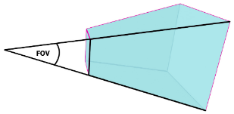
Camera
new THREE.PerspectiveCamera(fov, aspect, near, far);
Imagem ^{[1]}
Notes:
The .fov or Field of View parameter defines the angle of the viewing frustum, that is, how much of the world can be seen through the camera. It’s specified in degrees (as we’ll see soon, this is an exception; most angles in three.js are expressed in radians). Another way to think of this is that the .fov parameter defines how much bigger the far clipping plane will be than the near clipping plane. The valid range for the FOV is from 1 to 179 degrees.
https://discoverthreejs.com/book/first-steps/first-scene/

Slide 15
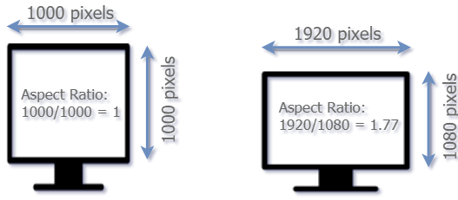
Camera
new THREE.PerspectiveCamera(fov, aspect, near, far);
Imagem ^{[1]}
Notes:
Aspect ratio
The .aspect ratio is the width divided by the height of the viewing rectangle. An aspect ratio of 1 will be a square, while window.innerWidth / window.innerHeight will be a rectangle with the same proportions as your current browser window (minus the portion at the top with the URL and browser controls). We’ve created a <container> element to hold our scene, and we’re using the width and height from that to calculate the aspect ratio.
https://discoverthreejs.com/book/first-steps/first-scene/

Slide 16
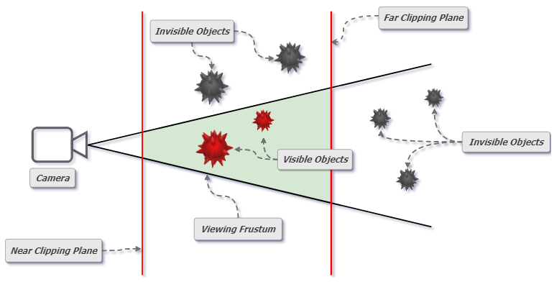
Camera
new THREE.PerspectiveCamera(fov, aspect, near, far);
Imagem ^{[1]}
Notes:
Clipping Planes
The .near parameter defines the near clipping plane. Objects closer to the camera than .near will not be visible. For a PerspectiveCamera, the near plane must be greater than 0, and less than the .far plane. This defines the smaller end of the frustum pyramid shape in the diagram above.
The .far parameter defines the far clipping plane. Objects further away from the camera than this will not be visible. For a PerspectiveCamera, this can be anything bigger than the .near plane. In practice, to make your scene efficient you will want this to be as small as possible. This defines the larger “base” of the frustum.
https://discoverthreejs.com/book/first-steps/first-scene/

Slide 17
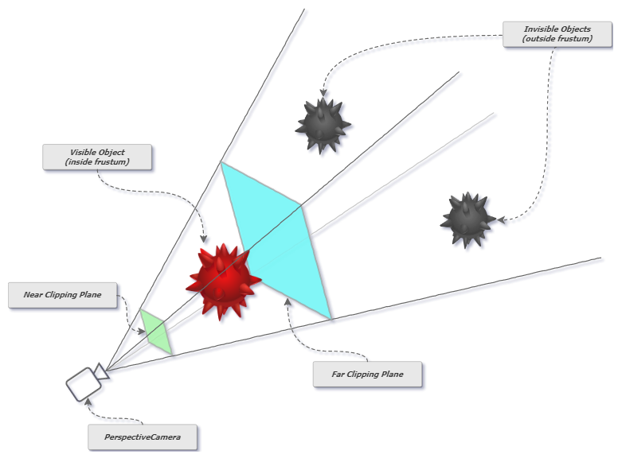
Camera
Imagem ^{[1]}
Notes:
The Camera’s Viewing Frustum
A frustum is a mathematical term meaning a four-sided rectangular pyramid with the top cut off. When we view the scene with our camera, everything inside the frustum is visible, everything outside it is not. In the following diagram, the area in between the Near Clipping Plane and the Far Clipping Plane is the frustum.
https://discoverthreejs.com/book/first-steps/first-scene/

Slide 18
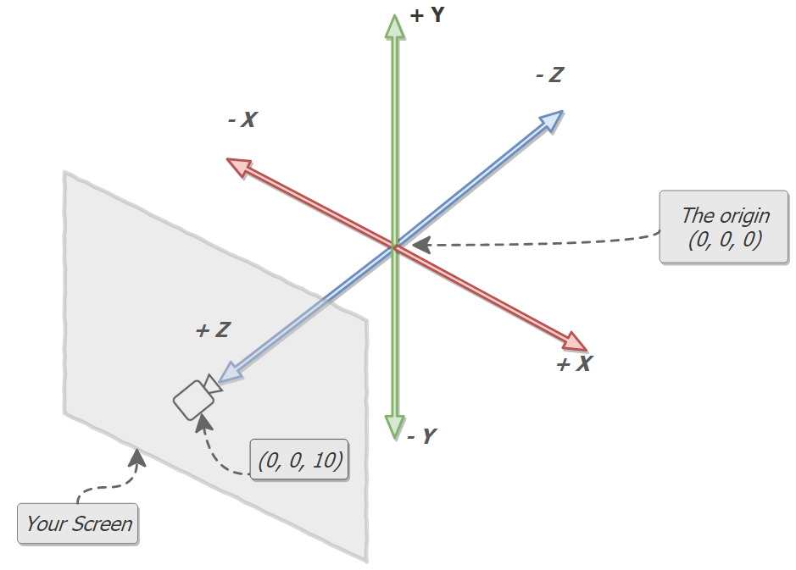
Sistema de coordenadas
Imagem ^{[1]}
Notes:
By default everything that we create is put at the point (0,0,0). This is called the origin.
The above diagram shows the three.js coordinate system, along with the camera we just created, and your screen. The point where the x-axis, y-axis, and z-axis meet is (0, 0, 0). As we just mentioned, this is called the origin, and we’ve moved our camera to the point (0, 0, 10) - ten units towards us.
Take note of the direction of the axes relative to the camera and your screen.
+X points to the right of the screen
-X points to the left of the screen
+Y points to the top of the screen
-Y points to the bottom of the screen
+Z points out of the screen (towards you)
-Z points into the screen (away from you)
With the line camera.position.set( 0, 0, 10 ), we’ve left the camera in the middle of the x-axis and y-axis, but moved it 10 units towards us along the z-axis.
https://discoverthreejs.com/book/first-steps/first-scene/

Slide 19
Renderer
camera = new THREE.PerspectiveCamera(fov, ratio, near, far);
scene = new THREE.Scene();
renderer = new THREE.WebGLRenderer({ antialias: true });
renderer.setSize(width, height);
renderer.render(scene, camera);
\exemplos\2-renderer

Slide 20
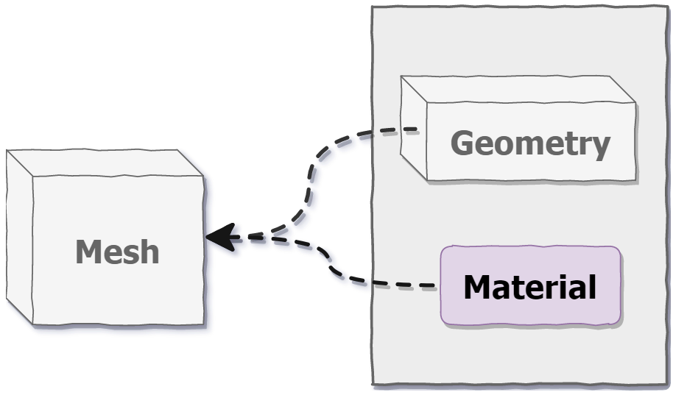
Mesh
Mesh
Imagem ^{[1]}

Slide 21
Mesh
const geometry = new THREE.BoxBufferGeometry(2, 2, 2);
const material = new THREE.MeshNormalMaterial();
const mesh = new THREE.Mesh(geometry, material);
Imagem ^{[1]}
Notes:
To do this, we’ll use a kind of object called a Mesh, which consists of three components - a Geometry (or rather a BufferGeometry, but more on that below), a Material, and the Mesh itself, which is a holder for the geometry and material and is used to set the position of the object inside the scene. We’ll make the geometry and material first, and then create the mesh to hold them.
https://discoverthreejs.com/book/first-steps/first-scene/

Slide 22
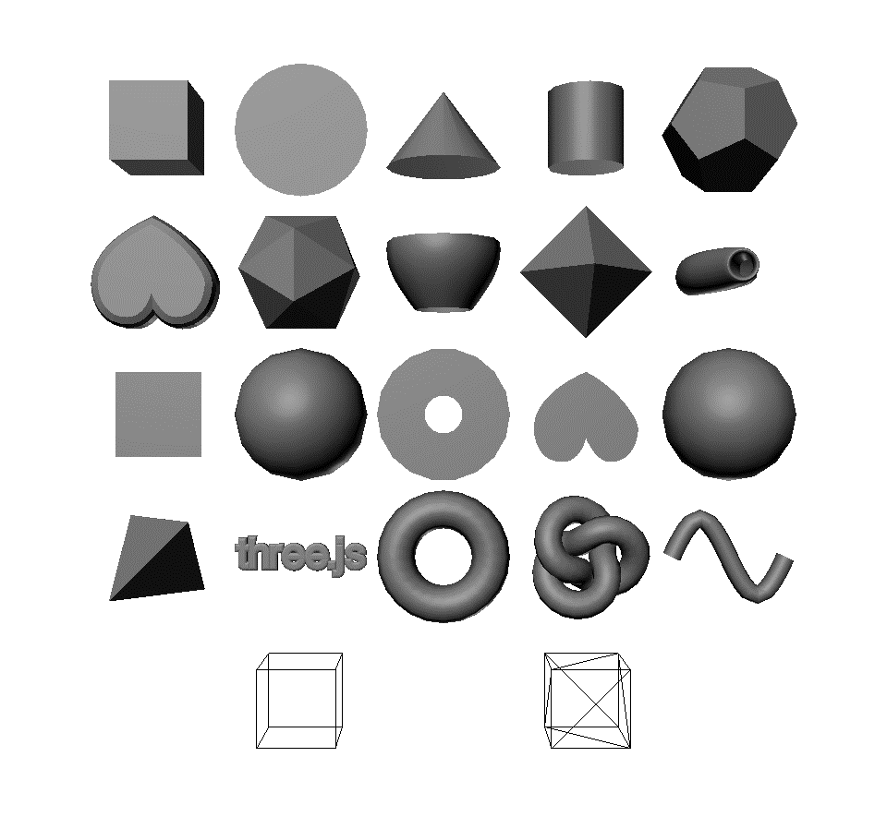
Geometrias
BoxBufferGeometry, BoxGeometry
CircleBufferGeometry, CircleGeometry
ConeBufferGeometry, ConeGeometry
CylinderBufferGeometry, CylinderGeometry
DodecahedronBufferGeometry, DodecahedronGeometry
ExtrudeBufferGeometry, ExtrudeGeometry
IcosahedronBufferGeometry, IcosahedronGeometry
LatheBufferGeometry, LatheGeometry
OctahedronBufferGeometry, OctahedronGeometry
ParametricBufferGeometry, ParametricGeometry
PlaneBufferGeometry, PlaneGeometry
PolyhedronBufferGeometry, PolyhedronGeometry
RingBufferGeometry, RingGeometry
ShapeBufferGeometry, ShapeGeometry
SphereBufferGeometry, SphereGeometry
TetrahedronBufferGeometry, TetrahedronGeometry
TextBufferGeometry, TextGeometry
TorusBufferGeometry, TorusGeometry
TorusKnotBufferGeometry, TorusKnotGeometry
TubeBufferGeometry, TubeGeometry
EdgesGeometry
WireframeGeometry
Primitivas
\exemplos\3-geometrias [1-6]
Imagem ^{[1]}
Notes:
The geometry of an object defines its shape. If we create a box-shaped geometry (like we are doing here), our mesh will be shaped like a box. If we create a sphere shaped geometry, our mesh will be shaped like a sphere. If we create a cat-shaped geometry, our mesh will be shaped like a cat, and so on.
https://discoverthreejs.com/book/first-steps/first-scene/

Slide 23
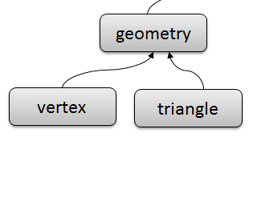
Geometrias
Personalizadas
Imagem ^{[1]}

Slide 24
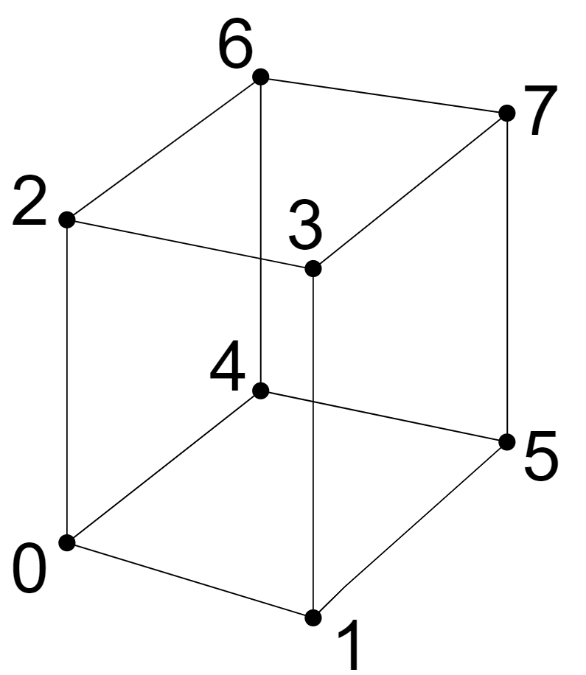
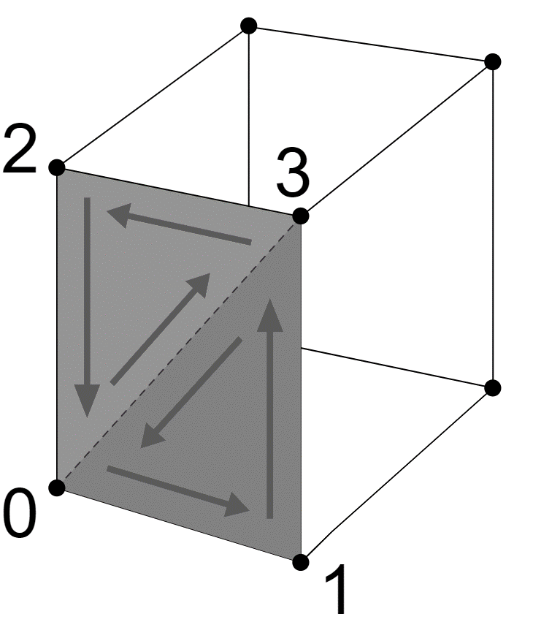
Geometrias
const geometry = new THREE.Geometry();
geometry.vertices.push(
new THREE.Vector3(-1, -1, 1), // 0
new THREE.Vector3( 1, -1, 1), // 1
new THREE.Vector3(-1, 1, 1), // 2
new THREE.Vector3( 1, 1, 1), // 3
new THREE.Vector3(-1, -1, -1), // 4
new THREE.Vector3( 1, -1, -1), // 5
new THREE.Vector3(-1, 1, -1), // 6
new THREE.Vector3( 1, 1, -1), // 7
);
geometry.faces.push(
// front
new THREE.Face3(0, 3, 2), new THREE.Face3(0, 1, 3),
// right
new THREE.Face3(1, 7, 3), new THREE.Face3(1, 5, 7),
// back
new THREE.Face3(5, 6, 7), new THREE.Face3(5, 4, 6),
// left
new THREE.Face3(4, 2, 6), new THREE.Face3(4, 0, 2),
// top
new THREE.Face3(2, 7, 6), new THREE.Face3(2, 3, 7),
// bottom
new THREE.Face3(4, 1, 0), new THREE.Face3(4, 5, 1),
);
Personalizadas
Imagem ^{[1]}

Slide 25
Geometrias
const geometry = new THREE.Geometry();
geometry.vertices.push(
new THREE.Vector3(-1, -1, 1), // 0
new THREE.Vector3( 1, -1, 1), // 1
new THREE.Vector3(-1, 1, 1), // 2
new THREE.Vector3( 1, 1, 1), // 3
new THREE.Vector3(-1, -1, -1), // 4
new THREE.Vector3( 1, -1, -1), // 5
new THREE.Vector3(-1, 1, -1), // 6
new THREE.Vector3( 1, 1, -1), // 7
);
geometry.faces.push(
// front
new THREE.Face3(0, 3, 2), new THREE.Face3(0, 1, 3),
// right
new THREE.Face3(1, 7, 3), new THREE.Face3(1, 5, 7),
// back
new THREE.Face3(5, 6, 7), new THREE.Face3(5, 4, 6),
// left
new THREE.Face3(4, 2, 6), new THREE.Face3(4, 0, 2),
// top
new THREE.Face3(2, 7, 6), new THREE.Face3(2, 3, 7),
// bottom
new THREE.Face3(4, 1, 0), new THREE.Face3(4, 5, 1),
);
Personalizadas
\exemplos\3-geometrias [7]
Imagem ^{[1]}

Slide 26





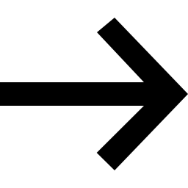



Geometrias
Importar modelos
.obj
glTF™
…
Loader
\exemplos\3-geometrias [8]

Slide 27
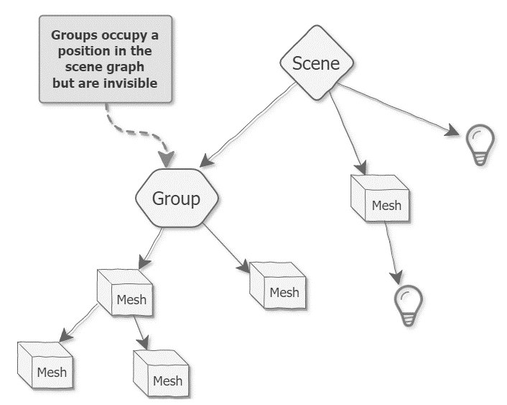
Geometrias
Grupos
\exemplos\3-geometrias [9]
Imagem ^{[1]}

Slide 28
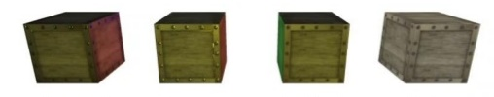
Material
const material = new THREE.MeshPhongMaterial({
color: 0xFF0000,
flatShading: true,
});
const material = new THREE.MeshPhongMaterial();
material.color.setHSL(0, 1, .5);
material.flatShading = true;
Imagem ^{[1]}
Notes:
Materials define the surface properties of objects - that is, which material that the object looks like it is made from. Where the geometry tells us that the mesh is a box, or a car, or a cat, the material tells us that it’s a metal box, or a stone car, or a red-painted cat.
https://discoverthreejs.com/book/first-steps/first-scene/

Slide 29
THREE.Color
m1 = new THREE.MeshBasicMaterial({color: 0xFF0000});
m2 = new THREE.MeshBasicMaterial({color: 'red'});
m3 = new THREE.MeshBasicMaterial({color: '#F00'});
m4 = new THREE.MeshBasicMaterial({color: 'rgb(255,0,0)'});
m5 = new THREE.MeshBasicMaterial({color: 'hsl(0,100%,50%)’});
material.color.set(0x00FFFF); // same as CSS's #RRGGBB style
material.color.set(cssString); // any CSS color, e.g.,
// 'purple’, '#F32',
// 'rgb(255, 127, 64)',
// 'hsl(180, 50%, 25%)'
material.color.set(someColor); // some other THREE.Color
material.color.setHSL(h, s, l); // where h, s, and l are 0 to 1
material.color.setRGB(r, g, b); // where r, g, and b are 0 to 1
Color names
Notes:
properties of type THREE.Color have multiple ways to be set.

Slide 30
Material
MeshBasicMaterial^{(*)}
MeshLambertMaterial
MeshPhongMaterial
MeshStandardMaterial
MeshPhysicalMaterial
+ RAPIDO
- REALISTICO
- RAPIDO
+ REALISTICO
Outros materiais (especiais):
MeshNormalMaterial, MeshDepthMaterial e ShadowMaterial.
\exemplos\4-material [1]
Material Feature Table
^{(*)} Não é afetado pela luz.

Slide 31
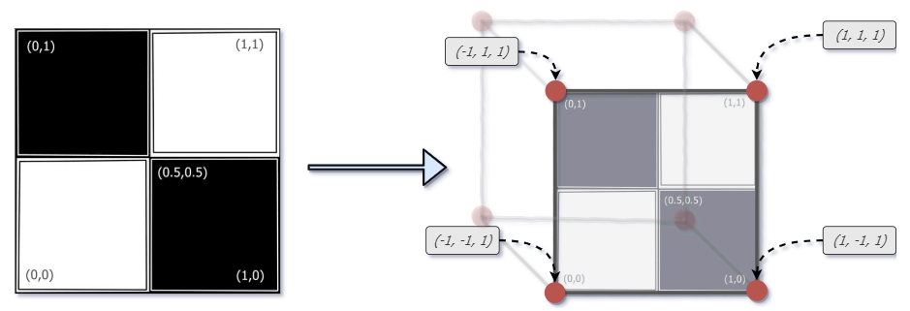
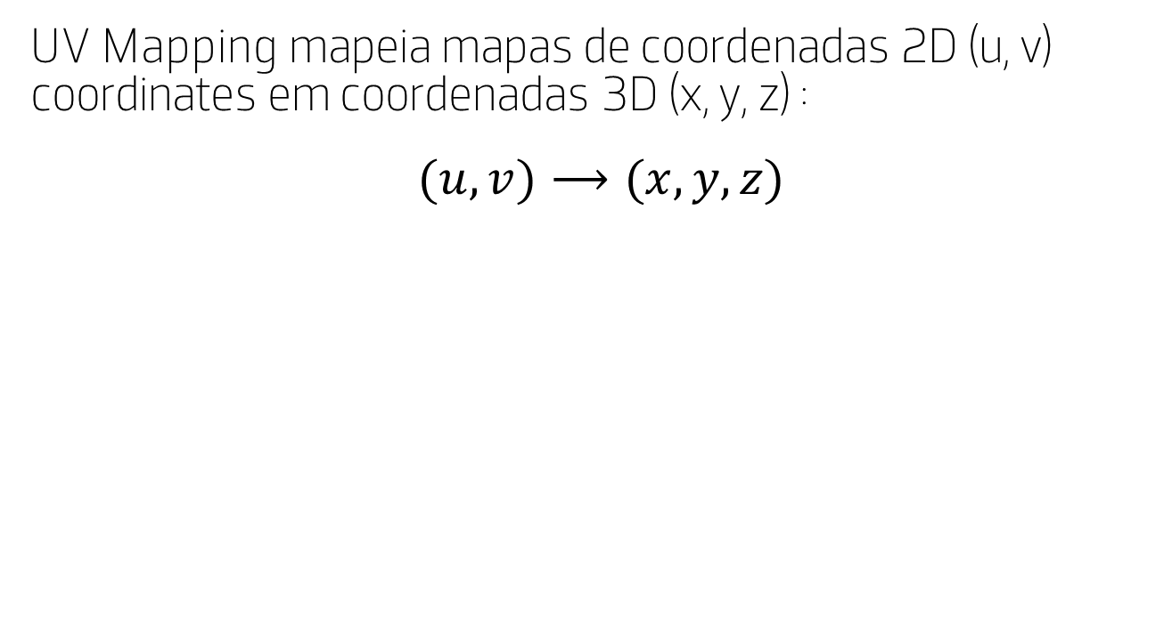
Texturas
UV Mapping mapeia mapas de coordenadas 2D (u, v) coordinates em coordenadas 3D (x, y, z) :
$$(u,v)⟶(x,y,z)$$
\exemplos\4-material [2-4]
Imagem ^{[1]}

Slide 32
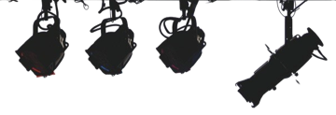
Luz
Luz
Imagem ^{[1]}

Slide 33
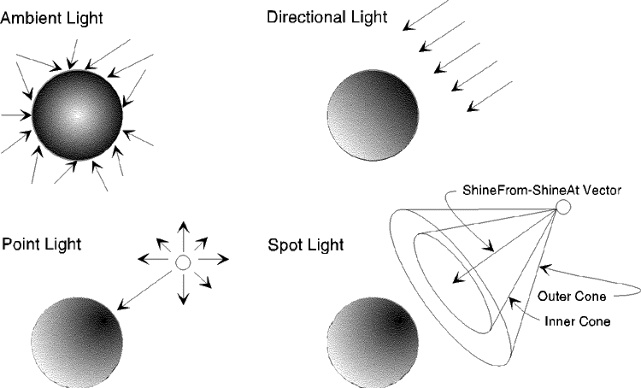
Luzes
AmbientLight
Luz que ilumina globalmente todos os objetos de forma igual.
PointLight
Luz emitida em todas as direções por um único ponto.
DirectionalLight
Luz emitida numa direção específica.
SpotLight
Luz emitida a partir de um único ponto numa direção ao longo de um cone.
HemisphereLight
Fonte de luz posicionada diretamente acima da cena, com a cor desbotando da cor do céu para a cor do solo.
\exemplos\5-luz [1-2]
Imagem ^{[1]}

Slide 34
Sombras
Configurar o renderizador
renderer.shadowMap.enabled = true;
// melhorar a qualidade das sombras
// renderer.shadowMap.type = THREE.PCFSoftShadowMap;
Configurar os objetos
object3d.castShadow = true;
object3d.receiveShadow = false;
Configurar as luzes
light.castShadow = true;
\exemplos\5-luz [3]
Notes:
O renderer calcula as posições das sombras.
Dois parâmetros controlam como os objetos interagem com luzes e sombras. Defina .castShadow como true se o objeto ocluir luz, para projetar uma sombra. Defina .receiveShadow como true se o objeto receber sombras.

Slide 35
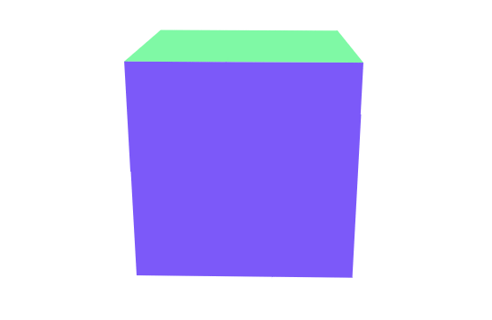
Animação
Animação
Imagem ^{[1]}

Slide 36
animate() {…}
function animate() {
requestAnimationFrame(animate);
mesh.rotation.x += 0.01;
renderer.render(scene, camera);
}
The window.requestAnimationFrame method tells the browser that you wish to perform an animation and requests that the browser call a specified function to update an animation before the next repaint. The method takes a callback as an argument to be invoked before the repaint. ^{[1]}
\exemplos\6-animacao [1]
Notes:
Recursively Calling animate() Using requestAnimationFrame()
Using requestAnimationFrame is pretty straightforward - the trick is to call it recursively. A recursive function is simply a function that calls itself repeatedly - refer back to our brief JavaScript Tutorial in the intro if this concept is unfamiliar to you.
So, we’ll call our animate function within our animate function, using requestAnimationFrame to handle the timing. Once we’ve done so, our app should be updating at a smooth 60 frames per second.
Well, except of course, that our scene doesn’t actually look any different. It may be updating at up to 60 frames per second, but nothing is moving so we can’t see that this happening.
https://discoverthreejs.com/book/first-steps/lights-color-action/

Slide 37
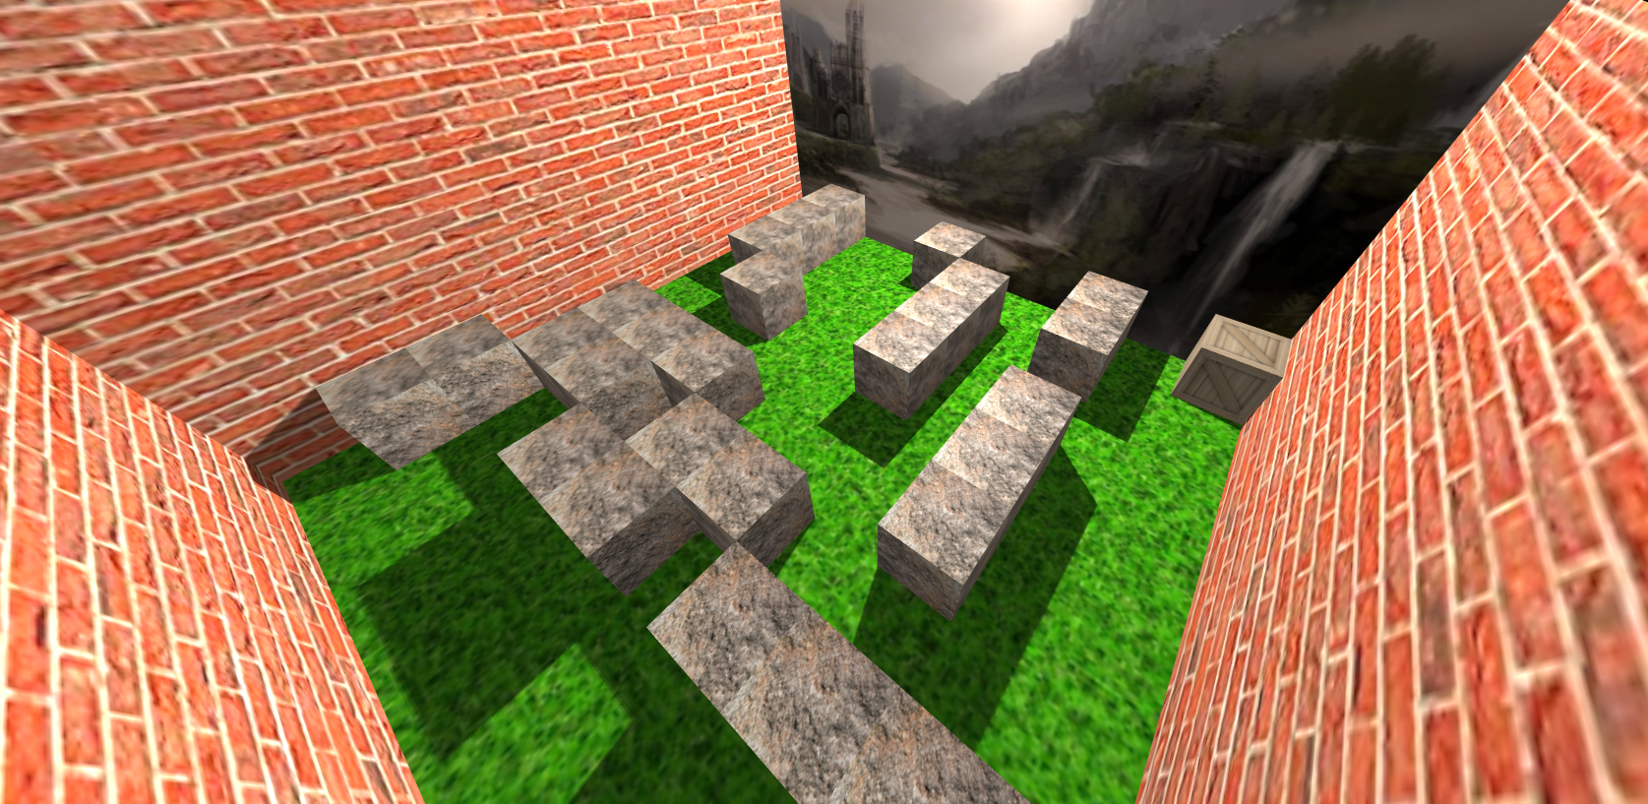
Animação
Exemplo - Labirinto
\exemplos\6-animacao [2]

Slide 38

Animações
O sistema de aninação (Animation System) do three.js é muito versátil e é muito semelhante ao sistema utilizado pelo Unreal Engine.
AnimationMixer - Controlador principal usado para controlar a aninação de um objeto.
Se manipularmos vários objetos serão necessários vários AnimationMixer.
AnimationAction – Determina como e quando as AnimationClip são executadas.
AnimationClip - Conjunto reutilizável de KeyframeTrack que representam uma animação.
KeyframeTrack - Sequência temporizada de keyframes usadas para animar uma propriedade específica de um objeto.
Saber mais:
Complexas
https://threejs.org/docs/#manual/en/introduction/Animation-system
https://www.youtube.com/watch?v=YjJuniW0ktk
\exemplos\6-animacao [mixer]

Slide 39
Conclusão
Conclusão

Slide 40


Praticar
"The only way to learn a new programming language is by writing programs in it."
Dennis Ritchie
\praticar

Slide 41
Recursos
https://threejsfundamentals.org/
https://discoverthreejs.com/
https://adolfoguimaraes.github.io/threejs/
https://www.youtube.com/watch?v=uzkedMF-l4Q
https://www.youtube.com/watch?v=8jP4xpga6yY
https://www.youtube.com/watch?v=6oFvqLfRnsU

Slide 42
Visualizações 3D para a web com WebGL
Visualizações 3D para a web com WebGL
Introdução ao Three.js
Introdução ao Three.js
Óscar Oliveira (oao@estg.ipp.pt)

